Slide 1



John Stelmaszek
Outdoors enthusiasts
4 children
Life long Floridian
Traveled to every (maybe) continent (except Antarctica) and over 80 different countries
Myers-Briggs: entp

Slide 2
Key Takeaways
Overview of cross-premises connectivity options
Best practice and patterns
Features & capabilities

Slide 3
Overview

Slide 4

Microsoft’s Global Network
One of the largest networks in the world
42 Azure regions
8000+ ISP sessions
100+ edge sites
44 ExpressRoute locations
33000 miles of lit fiber
Same network for Bing, Office 365, Skype, XBOX and Azure

Slide 5
The big (network) picture
Virtual network
“Bring your own network”
Segment with subnets and network security groups
Control traffic flow with user defined routes
Service Endpoints for private, secure access to Azure PaaS
Network Watcher
Monitors, logs, insights
Azure
virtual network
Users
Internet
Front-end access
Dynamic/reserved public IP addresses
Direct VM access, ACLs for security
Load balancing
DNS services: hosting, traffic management
DDoS protection service
Web Application Firewall (WAF)
Backend connectivity
ExpressRoute VPN Gateways
Backend connectivity
Point-to-site for dev/test
VPN Gateways for secure site-to-site connectivity
ExpressRoute for private enterprise grade connectivity

Slide 6





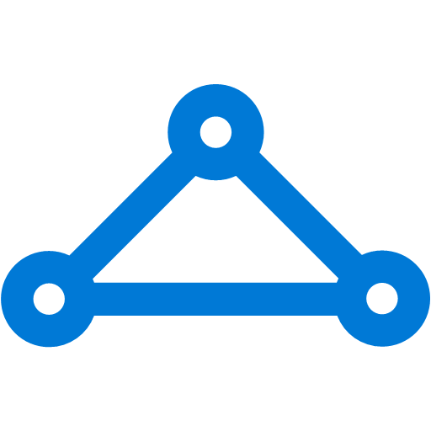
Hub-and-Spoke Architecture
Hub-and-Spoke
Hub-and-spoke in each region with VNet peering and Service Endpoints
Global VNet peering
Connecting Azure regions together
Direct VM-to-VM over Azure backbone
ExpressRoute
Private connectivity into Microsoft Clouds
High-throughput with carrier QoS
S2S VPN
Cross-premises connectivity over the Internet
Secure connectivity over Internet
P2S VPN
Connect to Azure VNet securely from ANYWHERE
Apple Mac, Windows with AD authentication
Azure Region 1
Azure Region 2
Azure
Azure
Azure
Hub
Hub
Vnet-to-VNet Tunnel
VNet Peering
S2S VPN Tunnel
S2S VPN Tunnel
P2S VPN
S2S VPN
ExpressRoute
From Internet
Customer Networks

Slide 7
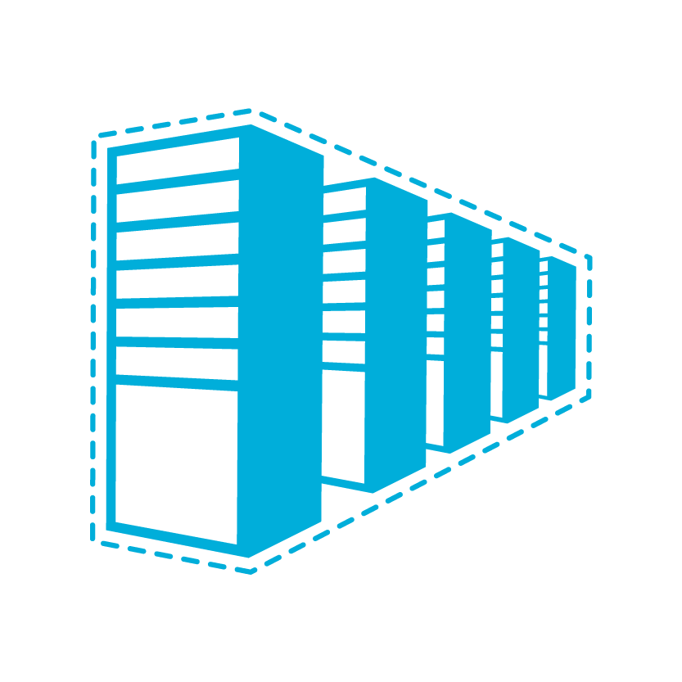


Connectivity options to Azure
Cloud
Customer
Segment and workloads
Consumers
Access over public IP
DNS resolution
Connect from anywhere
Internet Connectivity
Developers
POC Efforts
Small scale deployments
Connect from anywhere
Secure point-to-site connectivity
SMB, Enterprises
Connect to Azure compute
Secure site-to-site
VPN connectivity
SMB & Enterprises
Connect to Microsoft services
Mission critical workloads
ExpressRoute private connectivity

Slide 8
Connectivity options within Azure
Cloud
Cloud
Segment and workloads
In-/cross-region VNet-to-VNet
Direct VM-to-VM connectivity
Peer VNets for routing and transit
VNet Peering
Same region or cross regions
Connectivity via Azure VPN gateways
VNet-to-VNet via gateway

Slide 9

Cross-premises connectivity
ExpressRoute
ExpressRoute as primary cross-premises connectivity
Multiple circuits for redundancy & better routing
ExpressRoute-VPN co-existence for highly available, redundant paths
S2S VPN
S2S VPN over Internet for remote branch locations
BGP & active-active configuration for HA and transit
P2S VPN
P2S VPN for mobile users & developers to connect from anywhere with macOS & Windows
AD/radius authentication for enterprise grade security
Azure Clouds
On-Premises Network
Azure
S2S VPN Tunnel
ExpressRoute
S2S VPN
S2S VPN Tunnels
Headquarters
P2S VPN
Custom Branch Offices
From Internet

Slide 10
New Features – ExpressRoute & VPN
Performance
6x VPN throughput
Improved UltraPerf ExpressRoute gateways (latency)
Monitoring
Azure Monitor for ExpressRoute & VPN
OMS Network Performance Monitoring for ExpressRoute
Network Watcher for VPN
Resource Health Check for ExpressRoute & VPN
Security & compliance
Custom IPsec/IKE policy for VPN
ExpressRoute Peering
Merging Microsoft & Azure Public Peering
Enterprise grade P2S
macOS support for P2S
AD (Radius)-based authentication
Routing & connectivity
ExpressRoute IPv6 for O365 & Azure public services
ExpressRoute route filter for Microsoft peering – selected services
ExpressRoute connection weight
Multi-site for policy-based firewalls
VPN BGP routes & peering status

Slide 11
ExpressRoute

Slide 12



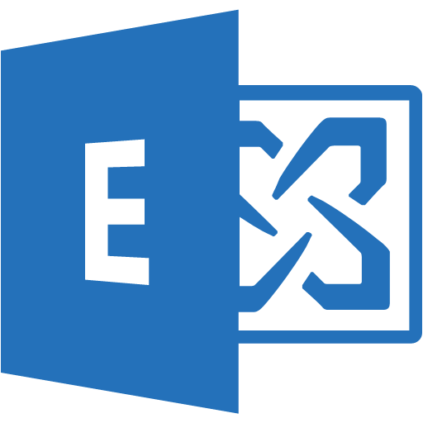
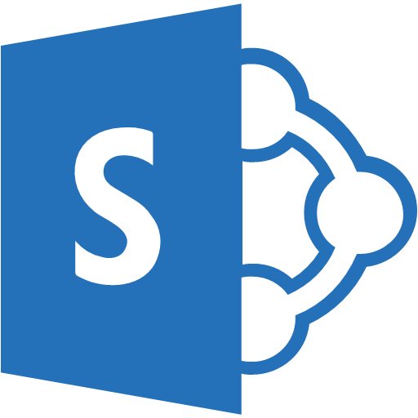


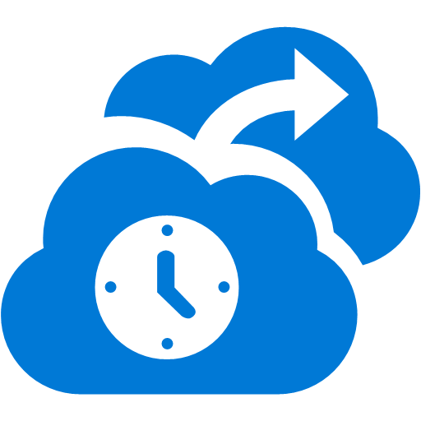









ExpressRoute
✔ Private connectivity to Microsoft Cloud Services
✔ Predictable performance
✔ Enterprise-grade resiliency with availability SLA
✔ Large and growing ExpressRoute partner ecosystem
Customer’s Network
Partner Edge
Primary Connection
Microsoft Edge
Secondary Connection
ExpressRoute Circuit
Microsoft Peering for Office 365 and Dynamics 365
Azure Public Peering for Azure public IPs
Azure Private Peering for Virtual Networks

Slide 13
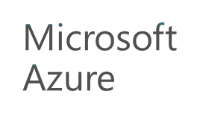

ExpressRoute connectivity models
ExpressRoute
ExpressRoute
ExpressRoute
Partner provides LAYER 2
service to the customer
Partner provide LAYER 3 service to the customer
WAN
Cloud exchange co-location
Point-to-point Ethernet connection
Any-to-any (IPVPN) connection

Slide 14
Montreal
Dublin
Seattle
Toronto
Newport, Wales
Amsterdam
Chicago
Quebec City
London
Paris
Seoul
Busan
Silicon Valley
Denver
New York City
Marseille
Las Vegas
Dallas
Washington DC
Tokyo
Los Angeles
Atlanta
Osaka
San Antonio
Miami
Hong Kong
34 ExpressRoute locations
Mumbai
Chennai
Singapore
Johannesburg
Sao Paulo
Cape Town
Sydney
Coming soon
Melbourne

Slide 15
ExpressRoute Premium provides global connectivity over Microsoft’s network

Slide 16
Government Cloud
Germany Cloud
Seattle
Berlin
China Cloud
Chicago
Silicon Valley
New York City
Frankfurt
Beijing
Dallas
Washington DC
Shanghai
Phoenix
San Antonio
12 ExpressRoute locations for National Clouds
Coming soon

Slide 17
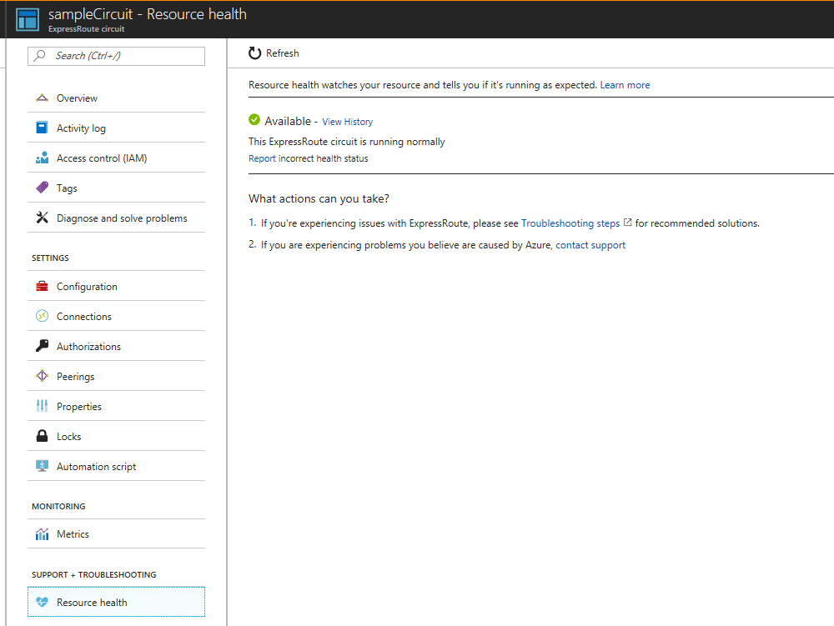
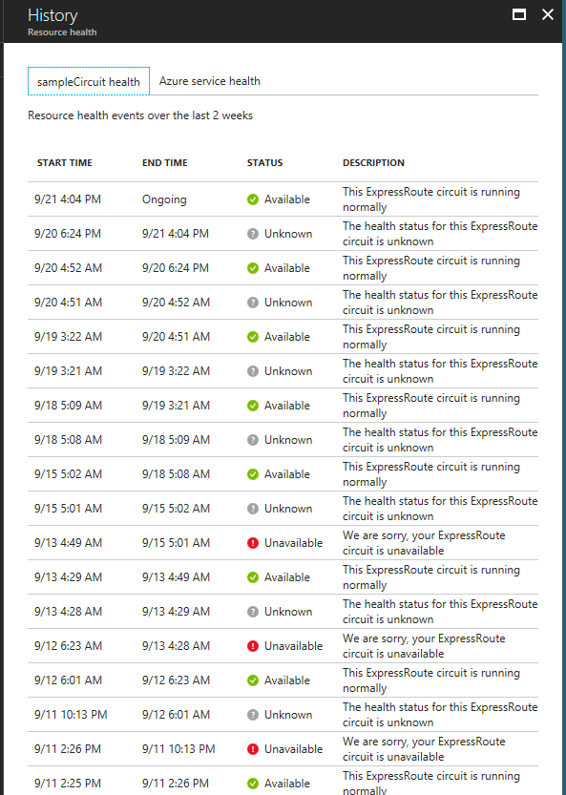
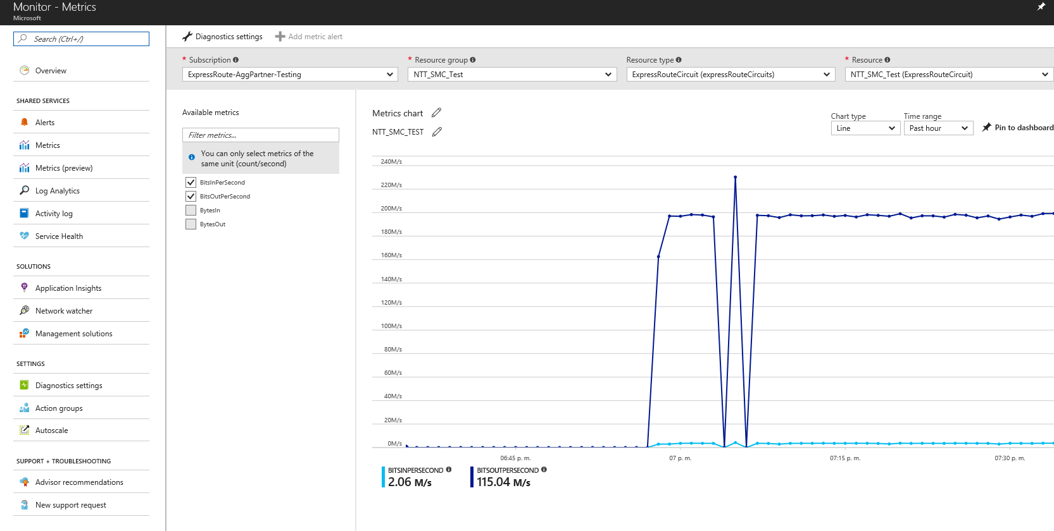
New features
Monitoring Preview
Resource Health Check (RHC)
Circuit metrics in Azure Monitor
Customer monitoring through Network Performance Monitor (NPM)
IPv6 support
Office 365 & Azure public services
Merging of Microsoft Peering and Azure Public Peering Preview
Azure public services on Microsoft Peering
Azure regions selectable through route filters
Bi-directional connections for services hosted on Azure
Azure Public Peering supported in near future
Customer’s network
Customer’s network
Partner Edge
Microsoft Edge
Partner Edge
Microsoft Edge
ExpressRoute Circuit
ExpressRoute Circuit

Slide 18
VPN – S2S & P2S

Slide 19
S2S VPN Taxonomy
Route-Based VPN
Traffic Selector: Any-to-Any
0.0.0.0/0 ⬅➔ 0.0.0.0/0
Routing tables to direct traffic into different tunnels
Up to 30 on-premises sites or VNets
Routing features
BGP & Transit
dynamically update routes
Active-active tunnels
Forced Tunneling
re-direct all Internet-bound traffic to on-premises
Policy-Based VPN
Traffic Selector: Prefix-to-Prefix
10.1.0.0/16 ⬅➔10.2.0.0/16 10.1.0.0/16 ⬅➔ 10.3.0.0/16
“Firewall”-based VPN
Connect to Azure route-based VPN gateways
“UsePolicyBasedTrafficSelectors” option
Requires IKEv2
Up to 30 on-premises sites
Does not support routing features

Slide 20
New VPN Gateway SKUs – 6x faster!
SKU | Workload | Throughput* | S2S/V2V | P2S | SLA
VpnGw1 | Production | 650 Mbps | Max. 30 | 128 | 99.95%
VpnGw2 | Production | 1 Gbps | Max. 30 | 128 | 99.95%
VpnGw3 | Production | 1.25 Gbps | Max. 30 | 128 | 99.95%
Basic | Dev/Test | 100 Mbps | Max. 10 | 128 | 99.9%
Scenarios
High throughput, hybrid workload over VPN tunnels
Failover from ExpressRoute circuits to S2S VPN tunnels
P2S for dev/test connectivity from anywhere
Roadmap
Higher throughput, more tunnels, easier migration
Connectivity

Slide 21
Secure VPN transit
BGP for redundant paths and dynamic routing Automatic shortest path selection and failover
Transit over Microsoft global network Secure connectivity using Internet only for “last mile”
ASN
VNet 3
Full mesh
65030
Redundant paths
Central US
BGP
BGP
ASN
65040
ASN
65050
BGP
BGP
BGP
VNet 2
VNet 1
S2S VPN
West US
East US
S2S VPN
On-Premises
ASN
65020
ASN
65010
On-Premises
Site 4
Site 5

Slide 22
Path diversity for on premises networks
Multiple tunnels/paths between Azure VNet and on premises site
Use BGP for reachability detection and path failover
Support on-premises network with multiple ISPs and VPN devices
VNet1
East US
ASN 65010
10.11.0.0/16
10.11.0.0/16
IPsec/IKE S2S VPN tunnel 1
Active tunnels with BGP failover
On Premises VPN 1
On Premises
Site 5
ASN65050
10.51.0.0/16
10.52.0.0/16
Azure VPN
IPsec/IKE S2S VPN tunnel 2
On Premises VPN 2

Slide 23
Dual Redundancy with Active-Active gateways
Zero downtime during planned maintenance
From active-standby to active-active
Support both cross-premises and VNet-to-VNet connectivity
Spreading traffic over multiple tunnels simultaneously
VNet1
East US
ASN 65010
10.11.0.0/16
10.11.0.0/16
Azure VPN
On Premises VPN 1
On Premises
Site 5
ASN65050
10.51.0.0/16
10.52.0.0/16
Azure VPN 2
On Premises VPN 2

Slide 24
Connecting Policy-based VPN devices (ASA)
Connect Azure VPN gateway to multiple policy-based VPN devices
“UsePolicyBasedTS”
Requires IKEv2
On Premises Site 2
10.2.0.0/16
On Premises ASA-1
On Premises Site 3
10.3.0.0/16
VNet1
10.1.0.0/16
Azure VPN
On Premises ASA-2
Traffic Selectors
10.1 ⬅➔ 10.2
10.1 ⬅➔ 10.3
10.1 ⬅➔ 10.4
10.2 ⬅X➔ 10.3
10.3 ⬅X➔ 10.4
10.2 ⬅X➔ 10.4
On Premises Site 4
10.4.0.0/16
Not Exist
On Premises ASA-3

Slide 25
Configurable IPsec/IKE policy
Compliance & security requirements
Per connection IPsec/IKE policy
Encryption, integrity, DH/PFS groups, SA lifetime
On Premises Site 2
10.2.0.0/16
Connection 1 policy:
IKE: AES256, SHA386, DH14
IPsec: GCMAES256, GCMAES256, PFS24
On Premises Site-2
VNet1
10.1.0.0/16
Azure VPN
Connection 2 policy:
IKE: AES128, SHA1, DH2
IPsec: AES256, SHA256, PFS24
On Premises Site 3
10.3.0.0/16
On Premises Site-3

Slide 26

P2S for macOS & AD authentication
P2S VPN
P2S VPN for mobile users & developers to connect from anywhere
Now supporting macOS and Windows
AD/Radius authentication for enterprise grade identity solution
Preview
VNet
On-Premises Network
Azure
AD/DS
AD/DS
S2S VPN Tunnel
Headquarters
S2S VPN
AD
Auth
P2S VPN
macOS,
Windows
From Internet
Connectivity

Slide 27
VPN download device scripts
S2S VPN
Apply custom IPsec/IKE policy for compliance (encryption/integrity, PFS, DH)
Download VPN device scripts for seamless configurations
Preview
VNet
On-Premises Network
Azure
Custom Policy
S2S VPN Tunnel
Headquarters
VPN device configuration scripts
Connectivity

Slide 28
Routing in Azure

Slide 29
Routing!
Can a hub talk to another hub?
VNet Peering, ExpressRoute, or VPN?
Can a spoke talk to another spoke in the same hub?
Can a spoke talk to another spoke in a different hub?
Global VNet Peering, ExpressRoute, or VPN?
Would Service Endpoint access get forced tunneled?
Would BGP advertised peered VNets prefixes to on-premises?
Would it take ExpressRoute or VPN to the on-premises networks?
Multiple ExpressRoute circuits?
Co-existence?
VPN Active-active?
Azure Region 1
Azure Region 2
Azure
Azure
Azure
Hub
Hub
VNet Peering
S2S VPN Tunnel
S2S VPN Tunnel
P2S VPN
S2S VPN
ExpressRoute
From Internet
Customer Networks
Connectivity
Notes:
We high light the new announcements
Vnet peering. We mention that the VPN tunnel between regions is replaced by the VNet peering. Bottlenecks are removed.
We highlight the fact that we can now talk to non-Windows clients – namely Apple IOS clients.
We highlight ExpressRoute and have a pop up box where we list the set of features (feature list will have 3 – 4 bullets).

Slide 30
How do I know which route(s) to take?
LPM (Longest Prefix Match) rules!
Routes with the longest prefix match of the destination will be taken
LPM == “more specific route”
10.0.0.0/24 is more specific then 10.0.0.0/16
Tie breaker – Static >> BGP >> System
Static routes
User-defined routes
Service endpoints*
VNet peering*
(*) Added by the system in UDR, but you can add routes to override
BGP / Gateway routes
BGP routes advertised via ExpressRoute or VPN ➔ Inject into the whole VNet
VPN gateway static routes
System routes
Intra-VNet direct & default to Internet
Hub-and-Spoke routing
Prefer VNet peering over ExpressRoute or VPN VNet-to-VNet
Prefer VNet Service Endpoints (Storage & SQL) over BGP routes (forced tunneling)
Prefer ExpressRoute over VPN in co-existence scenarios
Prefer ExpressRoute connections with higher connection weight
Prefer “shortest” path – honor AS prepending
Spoke-to-spoke in one hub is NOT connected by default – VNet peering is non-transitive
Spoke-to-spoke between two hubs works through gateway transit
Connectivity

Slide 31
How do I control which route(s) to take?
ECMP – Equal-Cost, Multi-Path
“When in doubt, spread …”
Multiple paths (nexthops) to the same destination
Two UDR routes to different virtual appliances
Active-active VPN gateway
Multipath topology via BGP routing
Spreading is on “flows”
Packets of one flow always follow the same path (gateways, tunnels)
Flow - 5-tuple (TCP/UDP)
Prefer one path over the others
MUST be done on BOTH ends
Prevent asymmetric routing
Azure ➔ on-premises network
AS-prepending – create longer AS paths for certain routes
Azure gateways will favor or prefer routes with shorter AS paths
ExpressRoute connection weight – prefer connections with higher weights
Apply higher connection weights to the closer ExpressRoute circuits
On-premises network ➔ Azure
Local preference
Connectivity

Slide 32

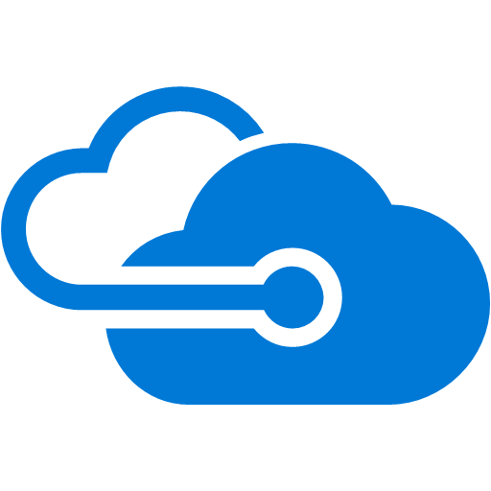

Connection weight and BGP attributes
US West
Microsoft Network
US East
W=100
W=100
Use connection weight to select the path from Microsoft to you
ExpressRoute
ExpressRoute
If both connection weight and AS-path prepending are applied, path is selected based on the former
Use “local preference” to select the path for traffic from you to Microsoft
Customer’s Network
Los Angeles
New York

Slide 33
Summary

Slide 34
VDC – Your Virtual Data Center
Hub-and-Spoke
Hub-and-spoke in each region with VNet peering and Service Endpoints
Global VNet peering
Connecting Azure regions together
Direct VM-to-VM over Azure backbone
ExpressRoute
Private connectivity into Microsoft Clouds
High-throughput with carrier QoS
S2S VPN
Cross-premises connectivity over the Internet
Secure connectivity over Internet
P2S VPN
Connect to Azure VNet securely from ANYWHERE
Apple Mac, Windows with AD authentication
Azure Region 1
Azure Region 2
Azure
Azure
Azure
Hub
Hub
Vnet-to-VNet Tunnel
VNet Peering
S2S VPN Tunnel
S2S VPN Tunnel
P2S VPN
S2S VPN
ExpressRoute
From Internet
Customer Networks

Slide 35
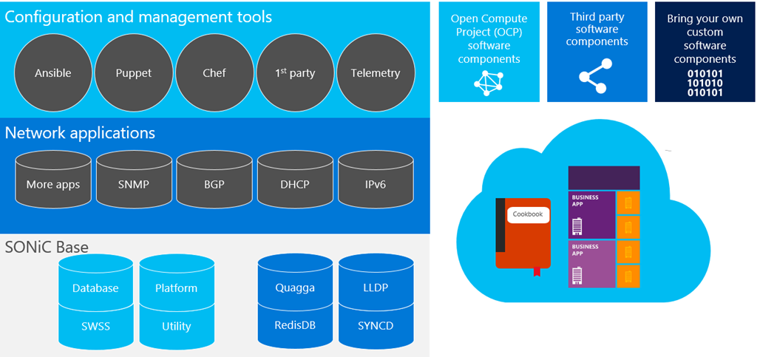
Get your own SDN with Microsoft SONiC
https://azure.microsoft.com/en-us/blog/sonic-the-networking-switch-software-that-powers-the-microsoft-global-cloud/
Notes:
SONiC is the first solution to break monolithic switch software into multiple containerized components. SONiC enables fine-grained failure recovery and in-service upgrades with zero downtime. It does this in conjunction with Switch State Service (SWSS), a service that takes advantage of open source key-value pair stores to manage all switch state requirements and drives the switch toward its goal state. Instead of replacing the entire switch image for a bug fix, you can now upgrade the flawed container with the new code, including protocols such as Border Gateway Protocol (BGP), without data plane downtime. This capability is a key element in the serviceability and scalability of the SONiC platform.
Containerization also enables SONiC to be extremely extensible. At its core, SONiC is aimed at cloud networking scenarios, where simplicity and managing at scale are the highest priority. Operators can plug in new components, third-party, proprietary, or open sourced software, with minimum effort, and tailor SONiC to their specific scenarios.

